Slide 1


Preparing a analytics report by capturing live data from a famous job portal for studying the behaviour of job market.
Project 02.
Mentor: Minakshi Gautam
Organization: OESON Private Ltd.
Presented By-
SHEIK ASHANUR RAHMAN

Slide 2

Project Description:
Problem Statement: You are given the dataset extracted from a famous job portal that explains the job status of various data-related jobs posted during the year 2023. The data explains the various job designations and related salaries from across the world. As a data scientist at Oeson, your job is to extract meaningful insight from this data to explain the actual remuneration each job title is providing across the globe. It will help recruiters understand the job requirements better in term salaries across different levels of work experience so that they can get proficient profiles for any data-related requirement.
Project Agendas:
• Get frequency of each year
• Get Average Salaries for each year
• Get frequency of job titles
• Get the top 10 most common data jobs
• Visualize average salaries by job titles and the top job titles with highest average salaries and least average salaries
• Visualize Average Salaries for the most common job titles
• Visualize distribution of job categories
• Average Salaries by Job Category
• Visualize average salary in USD based on currency
• Visualize average salary based on employee residence and company location
• Visualize salary based on experience level
• Visualize average salary based on employment type, work setting and company size.

Slide 3

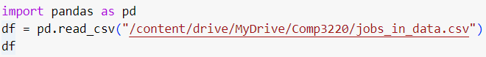
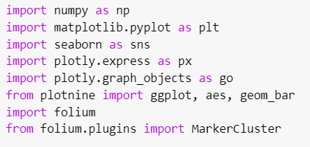
DATA EXPLORATION AND TOOLS
The data has been explored by Python Coding and analysed two ways.
1. Analysis Libraries: there are so many powerful libraries in Python like NumPy, SciPy, Pandas and so on. These help to provide data structures and functions for efficiently manipulating and analysing data.
2. Data Visualization: Matplotlib and Seaborn libraries help to create a wide range of static and interactive visualizations. Visualizations help in understanding patterns, trends, and relationships within the data

Slide 4

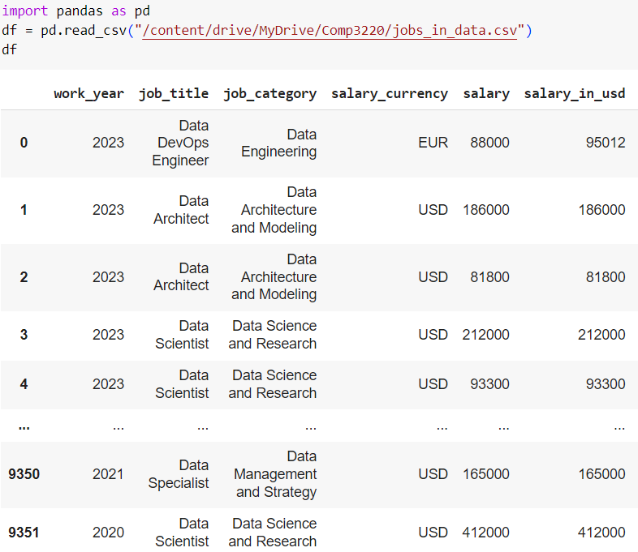
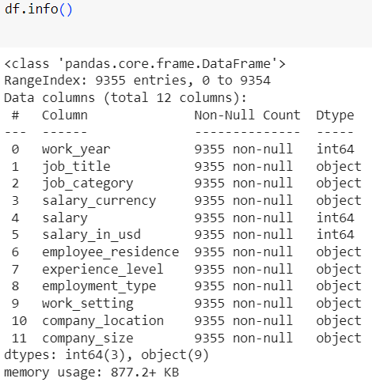
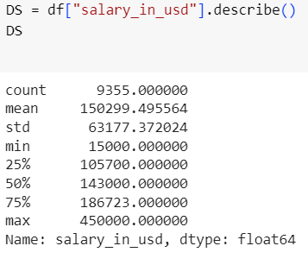
SAMPLE OF JOB DATA
DATA INFORMATION.
DESCRIPTIVE STATISTICE.
The above job data has 12 columns as job characters and 9355 rows with non-null value which will helps to reciters for employee requitements and also has descriptive statistic of “salary in USD” which will provide idea about offering salary to the employees.

Slide 5

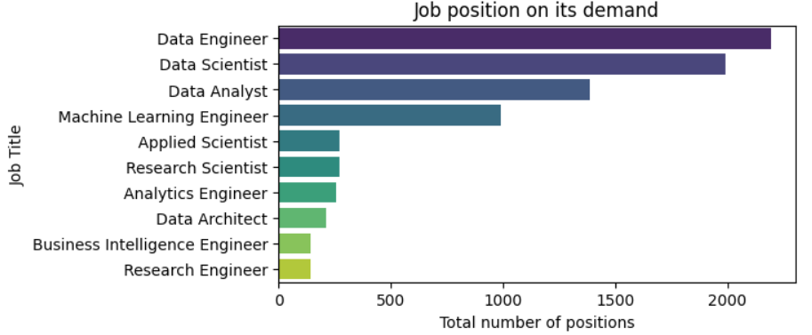
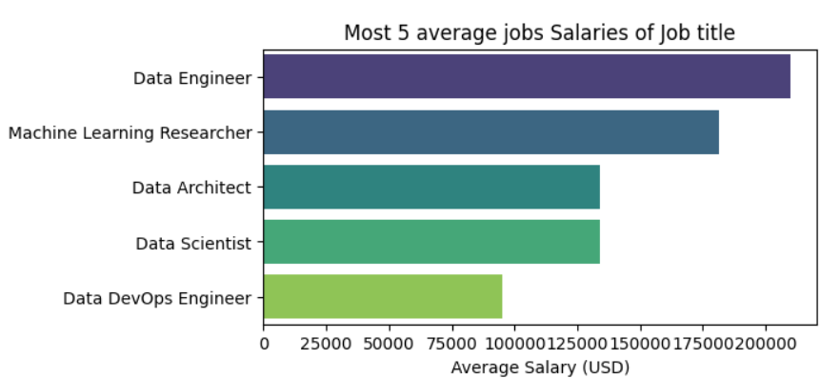
The chart is showing that The Data Engineer position out of top 10 has highest popularity or demand than others. It is over 2000 out of 9355 positions. The data scientist is in second position.
The chart is showing that the Data Engineer out of top 5 jobs position has highest average salary in the job market than others. Its offer salary is over USD $200000. The second position is the Machine learning Researcher.

Slide 6

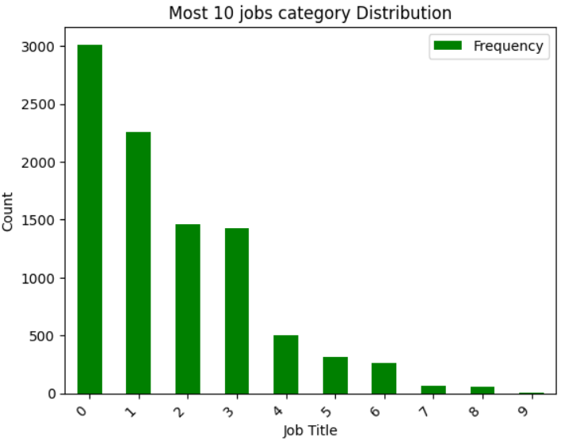
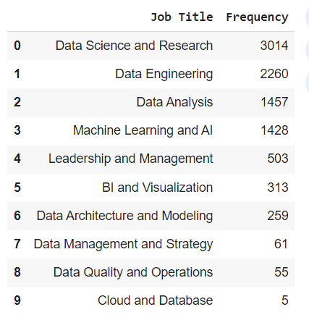
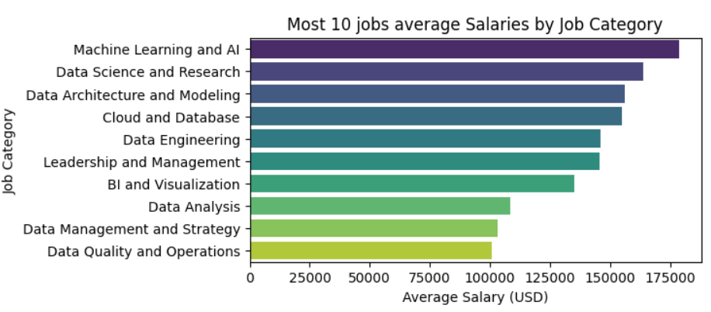
The chart is showing that the Machine Learning and Al out of top 10 job category has highest popularity in the job market than others. Its offer salary is over USD $200000. The second position is the Data Science and Research.

Slide 7

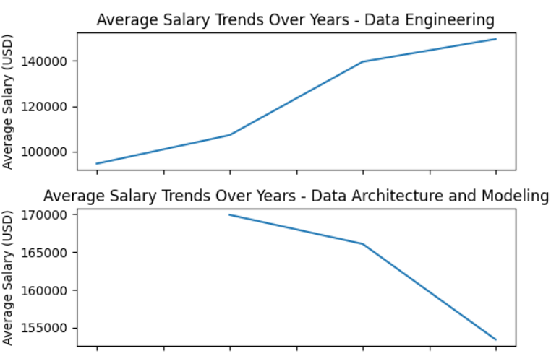
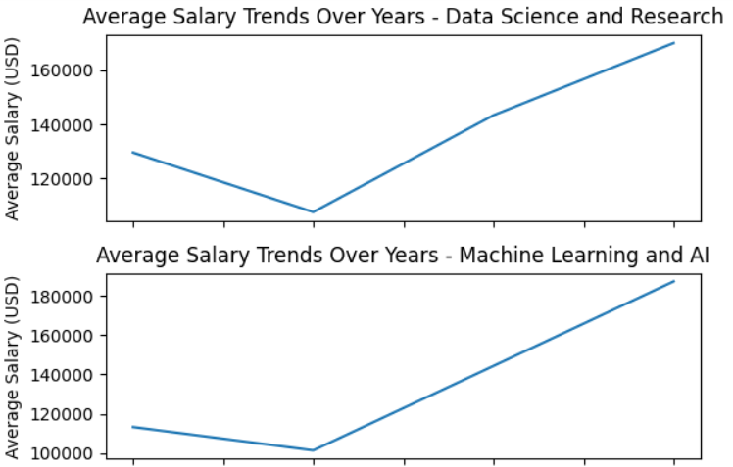
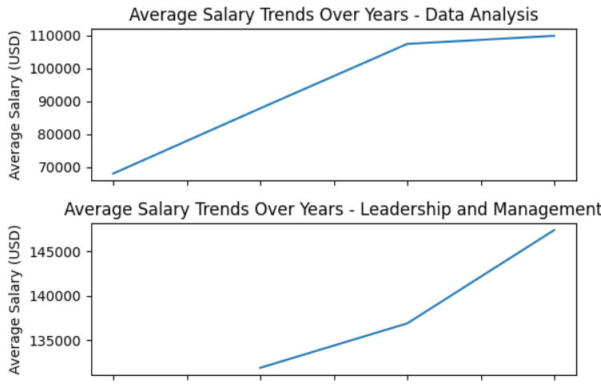
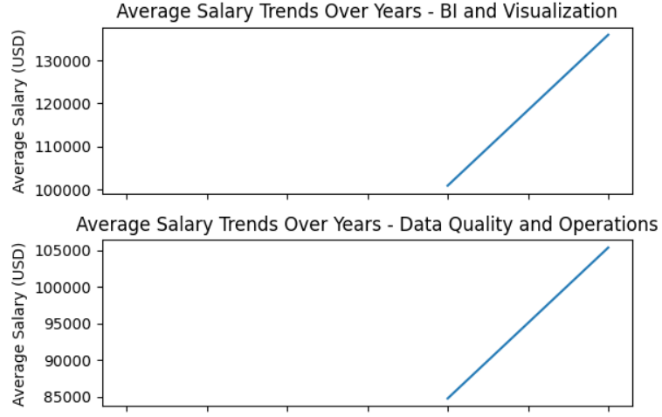
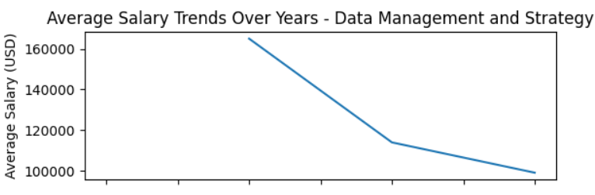
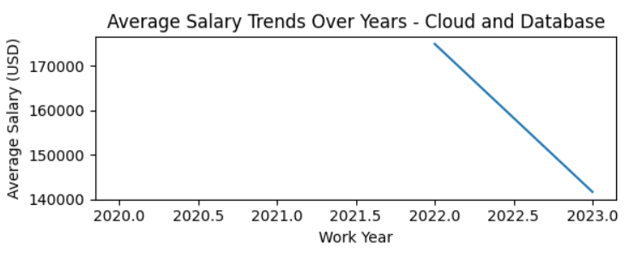
The above charts are showing the trends of average salary growth in the job market over 2020 to 2023. The Data Engineering has quick positive growth. The Data Analysis, Leadership and management, BI and Visualization and Data Quality and Operation have also positive growth. But the Data sciences and Research has a bit negative, then high positive growth as salary. Others have negative impact on salary in the job market.

Slide 8

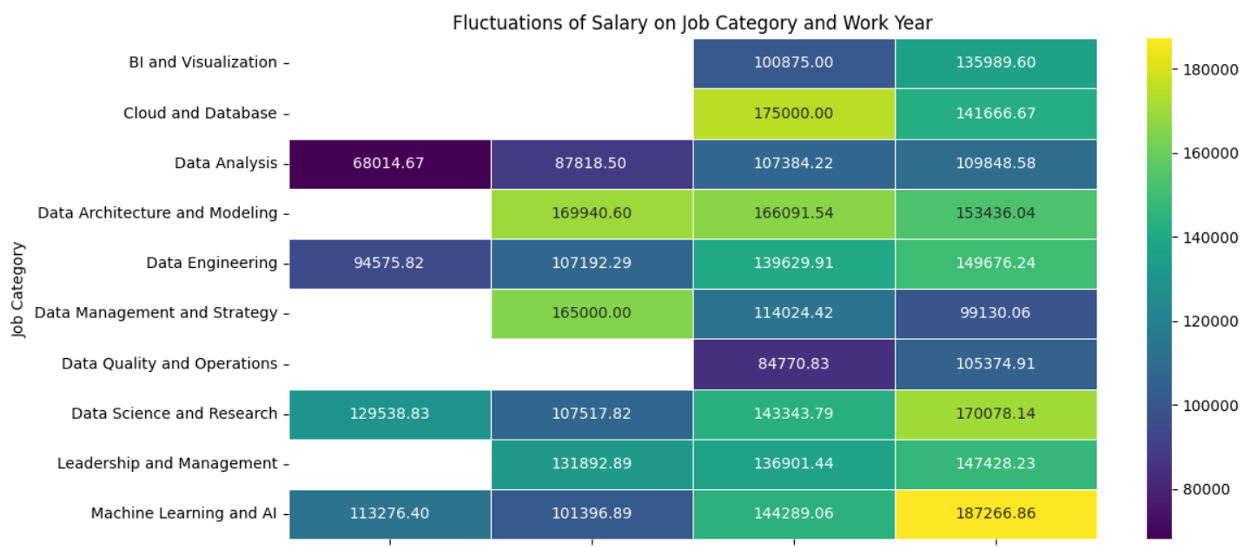
The above map is showing the fluctuations of salary on Job Category and Work Year. The job category of “Leadership and Management” has close to same over the years. But the salary of others have fluctuated over years as positive.

Slide 9
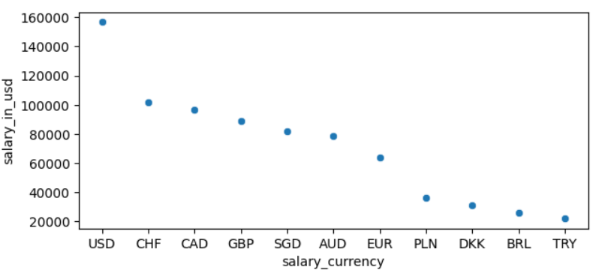
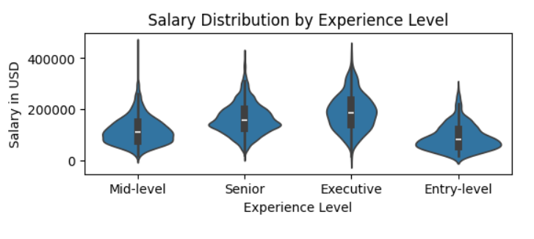
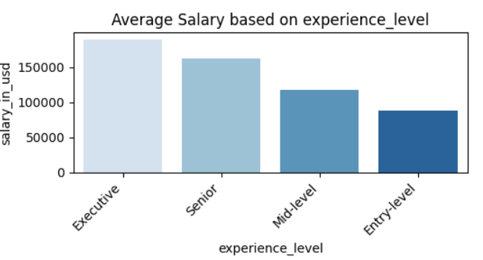
The above graph is showing how to distribute salary over experience level. Mid level is around USD $100000 on average, but entry level is under it. On other hand, Executive is around USD $200000 on average, but Senior level is under it.
The above graph is showing that the most and highest of salary have been paid in USD currency over 2020 to 2023 for Executive level and lest for Entry level. Lest currency is TRY

Slide 10

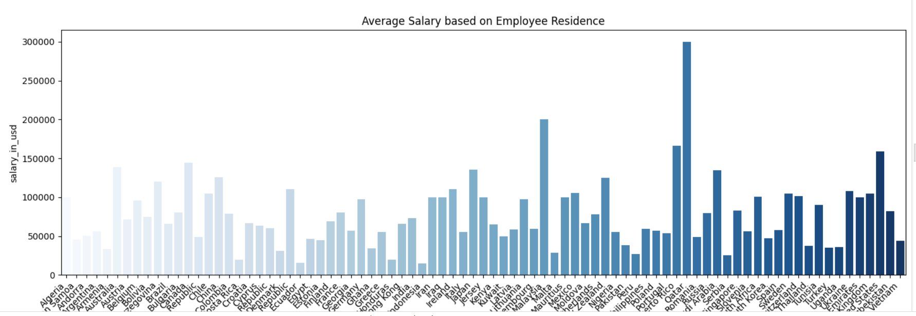
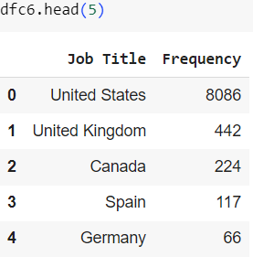
The above graph is showing that the highest salary is in Oater and second is in Malaysia. But United States is in third position with highest number of job positions. Where United Kingdom is second position in job numbers, but average salary is medium than others.

Slide 11

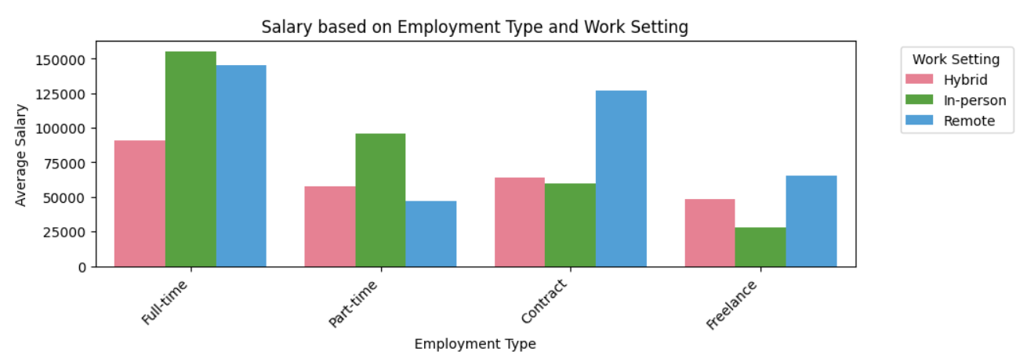
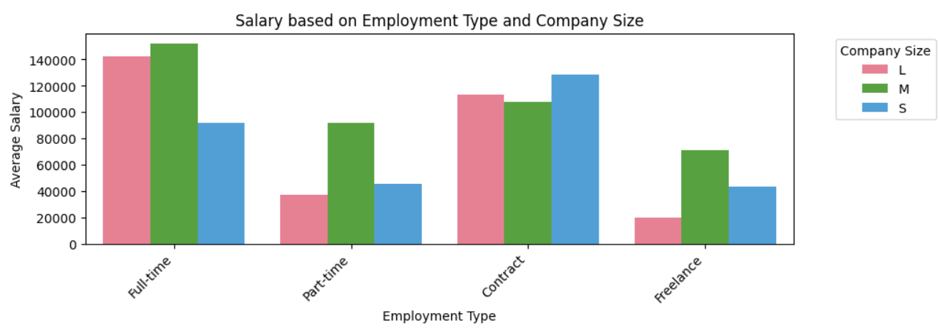
It is showing that the average salary Full time position is more than others in situation of “Work Setting”. Others are different in different situations.
It is showing that the average salary of Full time position is more than others in situation of “Company Size” of ‘L’ and ‘M’, but not ‘S. Others are different in different situations.

Slide 12
DATA AND INSIGHTS ANALYSIS:
The most important result of the above data and its insights analysis is the very demanded and high salary jobs are mostly data related in the developed countries.
Job demand: the data related jobs like data engineer, data scientist, machine learning, and so on are high level in the job market for all level. It is growing more and more day by day.
Interest of demand: it is paid high salary and it has deferent categories or opportunities or branches like data analysis. Data engineer, data architecture and modelling, data quality and operations, and so on.
High paid salary: it the high paid and prestigious technologist base job. It is growing opportunities in the developed countries like Quater, USA, and so on.
Level of works: It has all opportunities for work. All has handsome salary than expectation. It has hybrid work type because technologist. Its salary is increased base on experiences. Its opportunities has been increased in the COVID-19 situation around 2020-2023.

Slide 13


CONCLUSION:
As a employee in data position, we have the opportunity to drive business strategy and have a tangible impact on how the organization moves forward. You'll get to the heart of complex business challenges, working closely with key stakeholders and using our expertise to advise on the best course of action.
The job outlook for data related position can grow in the future as more organizations seek these professionals to make decisions to improve business processes. It's also easier to transition or advance to other industry roles with relevant data working experience.

